Slide 1
The Talent Imperative:
Engaging Your People Wherever They Are
MCM NFP Summit
June 15, 2023
Notes:
The Talent Imperative: Engaging Your People, Wherever They Are
The banking industry has been on the path of HR transformation since the disruption caused by the pandemic and the subsequent changing expectations of the workforce of the future. The result has been predictable: an unprecedented battle for talent that will continue to redefine your people strategies & priorities in the next decade.
Talent has become the primary driver of business success in the banking sector, and financial institutions that don’t pay attention to their people and transform their people practices will increasingly find themselves falling behind.
Those institutions that win in this century will be the ones that figure out how to reinvent, retool, and refocus their organizations to put people first and engage people where they are:
Now is the time to double-down on your people strategies.
What can you be doing now to retain your most highly-valued employees?
What does your talent pipeline look like?
Do you have a competitive compensation & benefits structure?
Do you have a clearly defined Employee Value Proposition?
Use OVCC CFMA Presentation as Base Deck 1/22
Annual Update:
Driving Forces for Change
Labor Market Updates/Predictions
Continued Challenges in Recruiting
Prioritizing the Employee Experience
Measuring and Driving Engagement
Building Leadership and Management Effectiveness
Org Design and Change Management
The Future of Work
Labor Market Still Stronger Than Economists Think: U.S. Added 263,000 New Jobs In November (forbes.com)

Slide 2
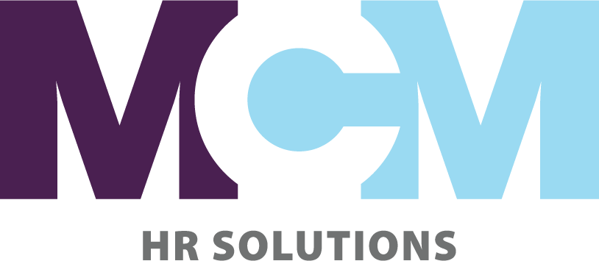
In 2023, has it been more difficult for your organization to attract and/or retain talent compared to previous years?
Yes
No
Notes:
Polling Questions:
In 2023, has it been more difficult for your organization to attract and/or retain talent compared to previous years?
Yes
No
What specific challenges has your organization faced in attracting and retaining talent? Choose all that apply
Insufficient number of qualified applicants
Rising wages in our market(s)
Rising wages for key positions
Disinterest in working for a Non-Profit
Competition on health care and other benefits
Do you believe that remote work/hybrid scheduling has helped attract and retain valuable employees?
Yes
No
Unsure
How do you believe remote work has affected your organization’s culture?
Positively
Negatively
Our culture hasn’t changed
Don’t know/Unsure
What are your top three people challenges for 2023?
Offering competitive pay
Retaining key people
Recruiting younger talent
Adjusting to a hybrid work environment
Tying compensation to performance
Succession Planning
Don’t know

Slide 3
2. What specific challenges has your organization faced in attracting and retaining talent?
Choose all that apply
Insufficient number of qualified applicants
Rising wages in our market(s)
Rising wages for key positions
Disinterest in working for a Non-Profit
Competition on health care and other benefits
Notes:
Polling Questions:
In 2023, has it been more difficult for your organization to attract and/or retain talent compared to previous years?
Yes
No
What specific challenges has your organization faced in attracting and retaining talent? Choose all that apply
Insufficient number of qualified applicants
Rising wages in our market(s)
Rising wages for key positions
Disinterest in working for a Non-Profit
Competition on health care and other benefits
Do you believe that remote work/hybrid scheduling has helped attract and retain valuable employees?
Yes
No
Unsure
How do you believe remote work has affected your organization’s culture?
Positively
Negatively
Our culture hasn’t changed
Don’t know/Unsure
What are your top three people challenges for 2023?
Offering competitive pay
Retaining key people
Recruiting younger talent
Adjusting to a hybrid work environment
Tying compensation to performance
Succession Planning
Don’t know

Slide 4
3. What are your top three people challenges for 2023?
Offering competitive pay
Retaining key people
Recruiting younger talent
Adjusting to a hybrid work environment
Tying compensation to performance
Succession Planning
Don’t know
Notes:
Polling Questions:
In 2023, has it been more difficult for your organization to attract and/or retain talent compared to previous years?
Yes
No
What specific challenges has your organization faced in attracting and retaining talent? Choose all that apply
Insufficient number of qualified applicants
Rising wages in our market(s)
Rising wages for key positions
Disinterest in working for a Non-Profit
Competition on health care and other benefits
Do you believe that remote work/hybrid scheduling has helped attract and retain valuable employees?
Yes
No
Unsure
How do you believe remote work has affected your organization’s culture?
Positively
Negatively
Our culture hasn’t changed
Don’t know/Unsure
What are your top three people challenges for 2023?
Offering competitive pay
Retaining key people
Recruiting younger talent
Adjusting to a hybrid work environment
Tying compensation to performance
Succession Planning
Don’t know

Slide 5
The Driving Forces
Continued Economic Uncertainty
Rising Inflation
90% Of CEOs Expect It To Rise Within 12 Months
Scarcity of Talent
50% Of HR Leaders Expect Increased Competition Over Next 6 Months
Global Supply Constraints
48% Of CFOs Believe Supply Chain Volatility & Shortages Will Continue
A Member of PrimeGlobal – An Association of Independent Accounting Firms
Notes:
Organizations face uncertain and confusing times Executives are facing a “triple-squeeze” of pressures: 1 Rising inflation: 90% of CEOs expect it to rise significantly within the next 12 months. 2 Scarce, expensive talent: 50% of HR leaders expect increased talent competition over the next six months. 3 Global supply constraints: 48% of CFOs believe supply chain volatility and shortages will last beyond 2022
If there’s one word to describe the mood of HR leaders as they get ready to head into 2023, it may be “uncertain.”
Management consulting firm Gartner describes that uncertainty as being fueled by a “triple squeeze” of pressures: economic upheaval, CEOs increasingly prioritizing the needs of their workforces and the mandate for HR to manage multiple tradeoffs (for instance, balancing cost savings amid a potential economic downturn with the need for increased talent investment).
As we emerge from the impact of the pandemic, companies are bracing for economic uncertainty that will further impact the well-being of the workforce. Our board members (and presumably most strategic HR executives) understand that no matter what lens we view this through, the success of the organization relies on the holistic well-being of our people…and the culture. For many companies, there is recognition that the transparency and openness discovered during the pandemic benefited their cultures—in fact, 43% of those we surveyed said their cultures became even healthier. Companies cited several improvements, such as more flexible work arrangements, leaders who “walk the talk,” employee empowerment, open and honest feedback, and boards that care about culture.

Slide 6
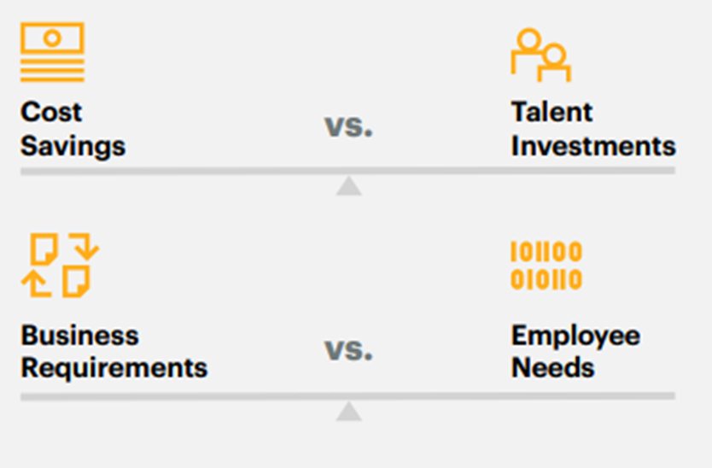
Talent Challenges in 2023/4
The Delicate Balance
A Member of PrimeGlobal – An Association of Independent Accounting Firms
Notes:
DEI all support and engage ALL people in an organization and allow people to feel like they BELONG

Slide 7
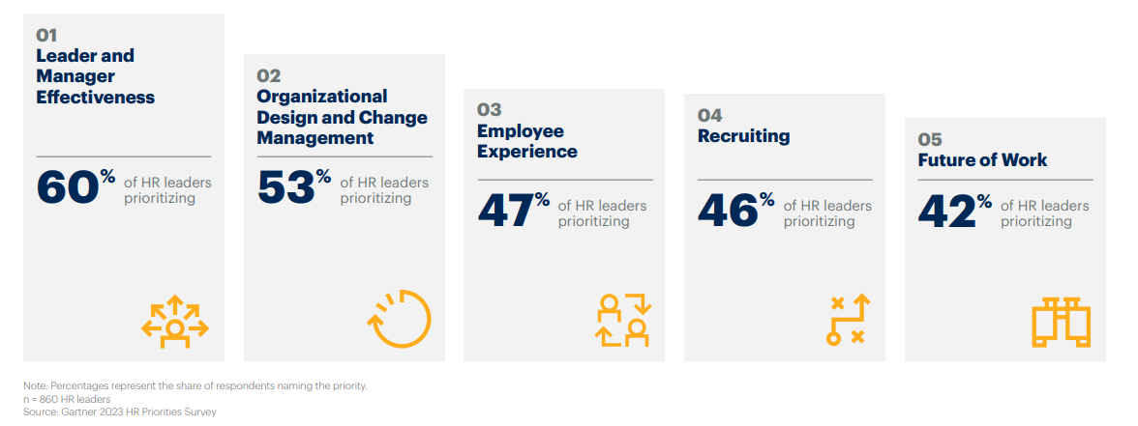
Talent Challenges in 2023/4
A Member of PrimeGlobal – An Association of Independent Accounting Firms
Notes:
DEI all support and engage ALL people in an organization and allow people to feel like they BELONG

Slide 8
Reframe
Managing Perceived Paradoxes Will Define Top Leaders.
A Member of PrimeGlobal – An Association of Independent Accounting Firms
Notes:
Successful leaders will be those who excel at demonstrating empathy while also achieving high levels of productivity as they manage hybrid teams. These leaders will not allow work models to dictate or impeded employees' sense of connectedness to the organization or co-workers, or their ability to collaborate effectively—nor will they permit talent to be subjected to proximity bias. A renewed focus on achieving outcomes (versus where or when someone works) will be the hallmark of these leaders.

Slide 9
Reframe
There's never been an opportunity like this for organizations to create real and lasting change.
Embracing a test-and-learn culture will entail a real mindset shift for some leaders.
The “big” answers may not emerge for years.
A Member of PrimeGlobal – An Association of Independent Accounting Firms

Slide 10
The Strategic Approach to HR
Purpose, Brand, Culture
Attract
Hire
Onboard
Depart
Engage
Perform
Develop
Strategic Workforce Planning
A Member of PrimeGlobal – An Association of Independent Accounting Firms
Notes:
The human-to-human dynamic in the workplace pushes leaders to display human-centric leadership, defined as leading with authenticity, empathy and adaptivity. These traits have been listed for some time among the key qualities of great leaders — but they were considered nice to have. Employees today demand them
Is the onus on HR to make it so?
In many cases, that’s probably the ticket. i4CP research in 2023 research found that most of the companies that have successfully renovated their culture possess a very strategic HR team and are usually led by an organizationally powerful chief people officer. But without a CEO who shares the same vision and is willing to put the effort into creating a healthier culture, there’s little even the most impressive CPOs can do to affect real change
1. Staying on the talent offensive & ensuring tight alignment to organizational strategy
2. Refocusing the employee value proposition and reinforcing it via a continually renovated culture
3. Avoiding burnout while also building and strengthening HR’s strategic capability
4. Building and rewarding ambidextrous leaders

Slide 11
Reframe
Experience Outside of HR is Now a Strategic Professional Building Block.
A Member of PrimeGlobal – An Association of Independent Accounting Firms
Notes:
Only 10% of senior HR leaders surveyed by i4cp indicated that their HR leadership team has significant experience working outside of the HR function. The pandemic showed most organizations that they need stronger alignment between HR and core business units, and it’s clear this will be extremely beneficial as market uncertainty continues. As corporate boards look for new directors with human capital expertise, individuals with multiple operating roles throughout the business will be more commonly appointed as HR executives in the future

Slide 12
What Does Your Talent Pipeline
Look Like?

Slide 13
Recruiting: The Talent Challenge
36% of HR leaders say their sourcing strategies are insufficient for finding the skills they need.
Continued Surge In Demand
New Normal For Attrition
Candidates Are Harder To Attract & Convert
A Member of PrimeGlobal – An Association of Independent Accounting Firms

Slide 14
Upskilling
Don’t Overlook Internal Talent Pipeline: Develop Skills Of Workforce
Prioritize/ Invest In Upskilling
A Member of PrimeGlobal – An Association of Independent Accounting Firms
Notes:
Tiffany
Many employers are beginning to invest more in Learning & Development (L&D), specifically upskilling and reskilling employees. Data from Gartner shows that the number of skills required for a single job is increasing by 10% annually, and over 30% of the skills needed just three years ago will soon be irrelevant. It generally costs less money to reskill a current employee than it does to hire an entirely new person.
Not only does upskilling employees benefit the workers themselves, but it also improves the company as a whole. Furthermore, employers are now more focused on internal mobility to bridge skills gaps and keep talented staff members from leaving.

Slide 15
Skills-Based Hiring
More Companies Are Piloting Skills-based Hiring
Setting Specific Skills & Competency Requirements For A Job Vs. Only Looking At A Candidate’s Credentials.
A Member of PrimeGlobal – An Association of Independent Accounting Firms
Notes:
Tiffany
With labor shortages estimated to continue through 2023, skills-based hiring may become more popular as a way to compete for talent. Skills-based hires may be more beneficial for employers in the long term, as they can train new employees on desired skills rather than focus mainly on experiences or education. With a well-developed learning and development program, companies can focus less criterion on specific qualifications that may not transfer well to adaptability or company fit.
Many employers are finding success by taking a chance on candidates who want to learn and grow with the company. Monitoring workplace trends is one way to stay ahead of the game and appeal to today’s workforce. HR functions have changed during the pandemic, so there are ways to evolve those strategies even further and make them sustainable for employees. These are some of the opportunities that Companies are presenting to candidates.
Skills based hiring expands the prospective talent pool but also allows internal employees opportunities greater visibility into their career mobility by providing them with educational pathways for specific industries and job functions.
Glassdoor reported that 15 companies ranging from Google to Hilton Hotels and Apple, are offering well-paying jobs to those possessing in-demand skills, but who may not have a College degree.
MCM Case Study: CES Construction client and mechanical aptitude test vs. hiring for work experience and skill/developing their own internal training strategy and investments

Slide 16
Purposeful Work/Make an Impact
Career Growth & Development
Rewards that Meet Them Where They Are
Sense of Belonging
Flexible Work
Changing Employee Expectations
A Member of PrimeGlobal – An Association of Independent Accounting Firms
Notes:
What the work Force of the Future Wants
Flexibility: 52% of employees say flexible work policies will affect their decision to stay at their organizations.
Shared purpose: 53% of employees want their organizations to take actions on issues they care about.
Well-being: 70% of companies have introduced new well-being benefits or increased the amount of existing wellbeing benefits.
Person-first experience: 82% of employees say it’s important for their organization to see them as a person, not just as an employee.4

Slide 17
Changing Employee Expectations
Flexibility
52% of employees say flexible work policies will affect their decision to stay at their organizations.
Shared Purpose
53% of employees want their organizations to take actions on issues they care about.
A Member of PrimeGlobal – An Association of Independent Accounting Firms
Notes:
Flexibility: 52% of employees say flexible work policies will affect their decision to stay at their organizations.
Shared purpose: 53% of employees want their organizations to take actions on issues they care about.
Well-being: 70% of companies have introduced new well-being benefits or increased the amount of existing wellbeing benefits.
Person-first experience: 82% of employees say it’s important for their organization to see them as a person, not just as an employee.
Gartner Survey -Gartner hr-top-priorities-2023-ebook.pdf

Slide 18
Changing Employee Expectations
Well-Being
70% of companies have introduced new well-being benefits or increased the amount of existing wellbeing benefits.
People First
82% of employees say it’s important for their organization to see them as a person, not just as an employee
A Member of PrimeGlobal – An Association of Independent Accounting Firms
Notes:
Flexibility: 52% of employees say flexible work policies will affect their decision to stay at their organizations.
Shared purpose: 53% of employees want their organizations to take actions on issues they care about.
Well-being: 70% of companies have introduced new well-being benefits or increased the amount of existing wellbeing benefits.
Person-first experience: 82% of employees say it’s important for their organization to see them as a person, not just as an employee.
Gartner Survey -Gartner hr-top-priorities-2023-ebook.pdf

Slide 19
Do You have a Clearly Defined Employee Value Proposition?
… and are you following through on those promises?
A Member of PrimeGlobal – An Association of Independent Accounting Firms

Slide 20
Employers who use EVPs successfully are 5X more likely to consider their employees highly engaged. (Deloitte 2021)
5X
A Member of PrimeGlobal – An Association of Independent Accounting Firms

Slide 21
Employee Value Proposition
PEOPLE
WORK
ORGANIZATION
OPPORTUNITY
REWARD
Belonging/DEI
Colleagues
Manager Quality
Mgt Support
Empowerment
Trust Leadership
Flexibility
Impact/Purpose
Innovation
Interest
LIFE/Work Balance
Purpose/Impact
Reputation
Culture
Social Responsibility
Diversity
Ethics
Industry
Customer Prestige
Growth & Development
Career Path
Growth Rate
Equity/Inclusion
Recognition
Business Stability
Compensation
Raises/Promotion
Health Benefits
Time off/Leave
Retirement
Flexible Rewards
Fairness
Education
Recognition
A Member of PrimeGlobal – An Association of Independent Accounting Firms
Notes:
Time to rethink your EVP:
This is a mutual agreement that is a clear, honest statement of what employees can and should expect from the organization, in exchange for their effort and loyalty.
The change is that we are now seeing this as a holistic approach
HR and people making these decisions (if there are not HR folks)
Help employees at all levels and stages : the message should be tailored to the unique needs as people progress throughout the Employee Life Cyle
From the CEO at Yahoo who also had career at Southwest.
We have to create a new definition of loyalty and trust period constantly re recruiting our people comma adhering to our values comma honest communication comma execution of our strategies and delivering results comma that's what will rebuild trust period we're not asking people to come to work for us For the rest of their lives dash those days are over. But we are asking them to come work for us and while they're here, trust us and feel good about it. As long as it's working for you and it's working for us, let's do something great together.
Includes things like compensation, company culture, opportunity to work with a well-known brand, growth and development, benefits and perks.

Slide 22
Your HR Team should be laser-focused on the employee value proposition (EVP) to ensure it resonates strongly, and is reinforced by the policies, programs, and interactions that shape employee experience.
i4CP, 2023
A Member of PrimeGlobal – An Association of Independent Accounting Firms

Slide 23
Flexibility:
There is No One-Size Fits All Solution.

Slide 24
Flexibility is not a concession, it’s a strategy.
Reframe
A Member of PrimeGlobal – An Association of Independent Accounting Firms
Notes:
. Flexibility is not a concession—it’s a strategy It’s clear that employees want a more palatable work-life blend versus balance, and many achieved this during the pandemic. Organizations that have ignored data and employee sentiment and opted to put an end to flexibility based purely on the preferences of senior leaders will be challenged to appeal to talent. The companies that are more likely to succeed in the future will leverage flexibility as a core talent attraction and retention strategy, which will lead to improved cultural health and financial performance.
Your HR Team should be laser-focused on the employee value proposition (EVP) to ensure it resonates strongly, and is reinforced by the policies, programs, and interactions that shape employee experience.

Slide 25
Questions
Do You Know What Your Employees Prefer?
How Did You Find Out?
What Are You Hearing From Candidates?
What Are You Hearing From People Who Leave?
A Member of PrimeGlobal – An Association of Independent Accounting Firms

Slide 26
One Size Does Not Fit All
Tailor Your Hybrid Model
Know Your Strategic Aim
Not A Democracy/Needs Of The Business
What Kind Of Talent Do You Want To Attract?
A Member of PrimeGlobal – An Association of Independent Accounting Firms

Slide 27
What Can You Do Now to Retain your HVP? (Highly Valued People)

Slide 28
Compelling Careers: Critical for Retention
44% of HR Leader believe their organizations lack compelling Career Paths.
A Member of PrimeGlobal – An Association of Independent Accounting Firms
Notes:
Data from a Gartner survey on employee career preferences shows that just one in four employees is confident about their career at their organization, and three out of four people looking for a new role are interested in external positions.

Slide 29
Focus on the Frontline Experience
45% of Frontline Workers plan to leave their job in next 3-6 months.
Disproportionate Value Creation is at the Frontline
Direct Manager/Supervisor Drives the Employee Experience
Employee Experience directly impact Customer Satisfaction/NPS
Engagement Surveys/Pulse Surveys Continue to be Effective Tool
A Member of PrimeGlobal – An Association of Independent Accounting Firms
Notes:
Across most industries, frontline employees are the human interface between the customer and the company. As a result, we typically see significant value creation and value capture happening disproportionately at the frontline.
Frontline employees drive significant value for organizations, but our research suggests they are struggling—in terms of engagement and building and maintaining networks at work—more than others. Leaders who effectively support these employees can see tremendous improvement in their ability to attract, mobilize, and retain their frontline talent.
However, the current experience for frontline workers is challenged, particularly with respect to their social capital—the presence of networks, relationships, shared norms, and trust among individuals, teams, and leaders. According to our research, 55 percent of U.S. frontline workers are dissatisfied with the number of and quality of relationships within their professional networks. Additionally, 72 percent say that they have low sponsorship, and 69 percent report low mentorship.
In turn, it comes as no surprise that 45 percent of frontline workers plan to leave their job in the next 3-6 months.
What can leaders do to increase frontline employee engagement, help strengthen networks, and ultimately retain their workforce?
Frontline employees drive significant value for organizations, but our research suggests they are struggling—in terms of engagement and building and maintaining networks at work—more than others. Leaders who effectively support these employees can see tremendous improvement in their ability to attract, mobilize, and retain their frontline talent.
Three actions to boost frontline engagement and retention | McKinsey & Company

Slide 30
Leader & Manager Effectiveness
Developing Leaders for Future of Work
24% of HR Leaders say Leadership is NOT prepared
Manager Effectiveness Drives the Employee Experience
Employee Experience Drives the Customer Experience
A Member of PrimeGlobal – An Association of Independent Accounting Firms
Notes:
Leaders Need a New Approach As today’s work environment changes, leadership must change, as well. The three environmental shifts of social and political turbulence, work-life fusion and flexible work arrangements are redefining the leader-employee dynamic into a human-to-human relationship.
Leader and manager effectiveness has long been identified as a top-five priority by respondents over the years, says Mark Whittle, vice president, HR Research & Advisory at Gartner. However, what’s changed this year is the context in which this and other priorities are being pursued—and which is greatly influencing how they’re going about accomplishing them.
“What has really changed is the lens through which we need to look at these things,” Whittle says. “In 2020, the lens was really focused on COVID and last year was a post-pandemic, kind of optimistic lens. This year, the lens is one of volatility, uncertainty, complexity and ambiguity. And that’s making it trickier than ever to put our HR strategy into practice.”

Slide 31
People-Centered Leadership
Source: Gartner study 2022
90% of HR Leaders Say That To Succeed In The Future,
Leaders Need To Operate In A More Human Way
A Member of PrimeGlobal – An Association of Independent Accounting Firms
Notes:
Gartner
Up until the last few years, leaders had a set framework: They were expected to enable workplace boundaries, address the work-related needs of their employees and manage a set of defined workflows. But, given the high stress of social and political turbulence, employees’ need for new levels of support and the increased variety of work patterns and norms that the last few years have brought, a new type of leader is now in demand. That person enables safe self-expression at work, addresses the “life”-related needs of their employees and is able to manage tailored flexible workflows, the Gartner report describes.
“These shifts are not creating entirely new responsibilities for leaders, but rather requiring leaders to achieve their core responsibilities in different ways, as the changing environment blurs the boundaries that previously the leader-employee dynamic,” Whittle said.
“The new dynamic,” Whittle added, “is not simply a leader-to-leader employee relationship, but a human-to-human one.”

Slide 32
How Do You Know Your Total Rewards are Competitive?

Slide 33
Increasing Wages & Raises
The Current Reality…
There Are More Open Jobs Than People To Fill Them
Inflation Continues To Impact Employee Pay Expectations
This Will Continue Through 2023
Companies Are Budgeting Overall Increase Of 4.1% For 2023
Most Significant Increase Since 2008
Median Raise Given To Those Who Changed Jobs Was 16.1%
Nearly Double The 7.6% Yearly Pay Change For Those Who Stayed
A Member of PrimeGlobal – An Association of Independent Accounting Firms
Notes:
The labor market today is such that there are more open jobs than people to fill them, and inflation is impacting employees’ pay expectations. And this reality will continue into 2023. Consequently, salary budgets for American employees are projected to increase in 2023.
According to Willis Towers Watson’s July report, companies are budgeting an overall average increase of 4.1% for 2023. This is compared with the actual 4% increase in 2022 and is the most significant increase since 2008. Forty-six percent of respondents said that employee expectations for higher pay are the top reason behind budgets increasing next year.
According to a recent ADP report, the median raise given to workers who changed jobs was 16.1%. This is interesting because it nearly double the 7.6% yearly pay change for those who stayed in their old job. Salary increases have become a way for organizations to keep up with the high costs of inflation and protect better positioned employees from financial insecurity. Employees are quick to job hop if they find an organization that can offer them a higher salary, so companies must be able raise their own wages in order stay competitive in the market.

Slide 34
Focus on in 2023/4
Year-Round Benefits Education
Pay Transparency
Flexible Benefits: Meet People Where They Are
Pay Matters, and so Does Career Development
Continue to Imbed Well-Being into Culture & Programs
A Member of PrimeGlobal – An Association of Independent Accounting Firms
Notes:
In the next few years, employees will be looking for more help than ever before to choose their benefits wisely and save as much money as possible. With inflation at an all-time high and a potential recession on the horizon, workers will want to get the most out of every penny they earn.
By guiding workers through benefits selection during key points of employment, employers have the opportunity to shine by deploying effective communication skills and providing year-round education.
During tough economic times, employees tend to look for more financial guidance from their employers. Because of this, many employers see benefits education as something that should happen year-round instead of just during open enrollment season. By continually educating employees about their benefits, employers can help avoid information overload and ensure that employees feel well-informed about their options and confident in their choices.
While raising wages is one way to attract and retain employees, research conducted by Paychex and Future Workplace among 603 full-time workers found 62% of employees identified well-being benefits as key a key factor in deciding whether to apply for a new job. This was especially true for Gen Z, where 67% strongly agreed or agreed that well-being benefits will be a priority for them in evaluating new job offers. The employee well-being benefits most in-demand include financial well-being and emotional/mental health well-being. Financial education and training are growing in importance for workers across generations. BrightPlan’s 2021 Wellness Barometer survey found over 80% of employees want support and guidance from their employers on personal finances - not only for retirement and financial education - but also digital budgeting, financial planning, and access to financial advisors.
In addition to financial wellness, nearly 30% of the workers surveyed in the Paychex and Future Workplace survey requested improved mental health support and resources. The Global Wellness Institute believes workplace mental health benefits will grow 9.8% annually over the next five years.
This should move HR leaders away from one-size-fits-all benefit solutions to a personalized approach to well-being benefits where the goal is to create a culture of care that meets the needs of all workers.
According to recent studies, two of the most important aspects for workers when choosing or staying with a company are compensation and clear development potential. Recently, California passed a pay transparency law. This means that organizations in the state must disclose salaries in job postings. Some other states have similar laws, but they only require disclosure upon request. It is likely that more municipalities and states will join the nationwide pay transparency movement. Consequently, many U.S. employers feel as if they have to supply salary information even though it isn’t legally mandated. This problem has been augmented by the rise of companies, such as Indeed and Glassdoor Inc., that post overall pay estimates and data for job postings—which can often be inaccurate.
Example – EAP Communication /Need to do this more!
Insurance vendors and Brokers – easy implementation

Slide 35
Focus on in 2023/24
Focus on the Frontline Experience
Simplify , Support & Enable the Manager Role
Intentional Leadership & Manager Development
Create, Communicate & Celebrate Career Paths
Making Hybrid & Flexible Work, Work
Imbedding Diversity, Equity, Inclusion & Belonging
Skills-based Hiring
Look Internally for Talent
A Member of PrimeGlobal – An Association of Independent Accounting Firms

Slide 36
People Drive Performance.
MCM HR Advisory Services
Maximizing People and their Potential.
Humans, not just Resources.
A Member of PrimeGlobal – An Association of Independent Accounting Firms
Notes:
Bottom Line is…It’s all about People!

Slide 37
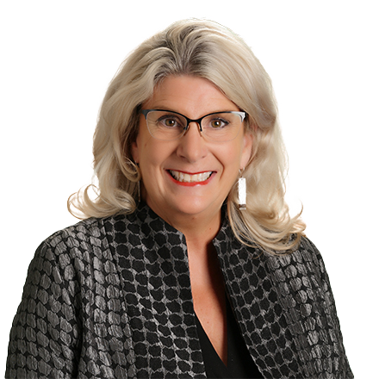
HR Advisory Team Leader & Principal Consultant
Susan.Pittman@mcmhrsg.com
502.882.4664

