Slide 1
Analytics for
Not-for-Profits
Notes:
Hi Everyone!

Slide 2
Tayaba Nadeem Business Intelligence Services Team Leader 317.224.1289 Tayaba.Nadeem@mcmtsg.com
5 years of experience at MCM
Bachelor of Science in Business from Kelley School of Business, IUPUI, May 2019
Fundamentals of Data Analytics Certificate, Purdue School of Science, IUPUI, May 2019
Master of Science in Technology from Purdue School of Engineering and Technology, IUPUI, May 2020
Pursuing Certified in Emerging Technology Professional Certification
Notes:
My name is Tayaba Nadeem. I lead MCM’s Business Intelligence Services Team, which falls under Risk Advisory Services. I work out of the Indianapolis office.
Over the course of my time here at MCM I have definitely moved my way around the firm. I started as an intern in January of 2018 with the Indianapolis team working in traditional financial statement audits. I then moved over to Risk Advisory Services working with the IT Audit team doing SOC and SOX work. In August of 2020, I transitioned to full-time and took over what we called data analytics services and since then I have almost completely changed everything, which I am excited to introduce to you today.
A bit about my education - I attended IUPUI where I earned a Bachelor of Science in Business from the Kelley School of Business in May 2019. I triple majored in Accounting, Finance, and International Studies and had double minors in Economics and Computer Information Technology. The Computer Information Technology minor was further specialized in Application Development, Web Design, and Database Management.
My goal was always to combine my business majors and technology minors and I knew the accounting industry was moving towards technology, automation, and analytics. So, I pursued a Fundamentals of Data Analytics Certificate from the Purdue School of Science, Department of Computer Science at IUPUI, which I also earned in May 2019. The certificate helped me truly decide where I wanted my career to go. And so, I then pursued a Masters of Science in Technology concentrated in Applied Data Management and Analytics and earned the degree in May of 2020 from the Purdue School of Engineering and Technology at IUPUI.
I am now pursing a professional certification in Emerging Technologies. A 4-part exam centered around Artificial Intelligence, Blockchain Technologies, Cloud Computing, and Internet of Things.
I did not tell you all that to boast about myself, the true purpose of me telling you all of this was to show that I am not just a data head or an accountant doing data things. I truly do have education and experience in both to be able to understand your needs and work with you to accomplish your organization's goal.
That said, let’s get back to why we are here!

Slide 3
Business Intelligence
Notes:
Introducing Business Intelligence! Business Intelligence is the newest service line of Risk Advisory Services at MCM.

Slide 4
What is Business Intelligence?
Data
Mining
Data
Analytics
Data Visualization
Data Tools and Infrastructure
Process of understanding data
Process of using data
Process of presenting data findings
Collection of systems housing or using data
Data-Driven Decisions
By transforming data to use for analytics, we can visualize our insights and make data-driven decisions leveraging software and services.
Notes:
But what is Business Intelligence or BI for short?
In technical terms, BI is the process of combining Data Mining, Data Analytics, Data Visualizations, and Data Tools and Infrastructure to get Data-Driven Decisions.
By transforming data to use for analytics, we can visualize our insights and make data-driven decisions leveraging our own software and services.

Slide 5
Why is Business Intelligence Important?
Aims to answer specific questions quickly using artificial intelligence
Encourages clients to administer data quality and security
Assists with data management
Notes:
Why is BI important?
From an Accounting Today report, organizations are transforming their accounting teams to be more efficient and proactive. They are using less time in finding the data and using more time in making decisions.
It is a way for management to quickly gain insights into their organization and make informed decisions all while using types of Artificial Intelligence
The need for data to be in a specific format to be able to clearly understand and use it aids in data quality and security.
BI helps organizations understand what type of data they have and how to effectively store and organize it.

Slide 6
Business Intelligence Services
Data Analytics
Data Strategy
Notes:
Now that we have a basic understanding of the overarching Business Intelligence umbrella, I would like to dive deeper into the services MCM is currently offering under the BI service line - Data Analytics and Data Strategy.

Slide 7
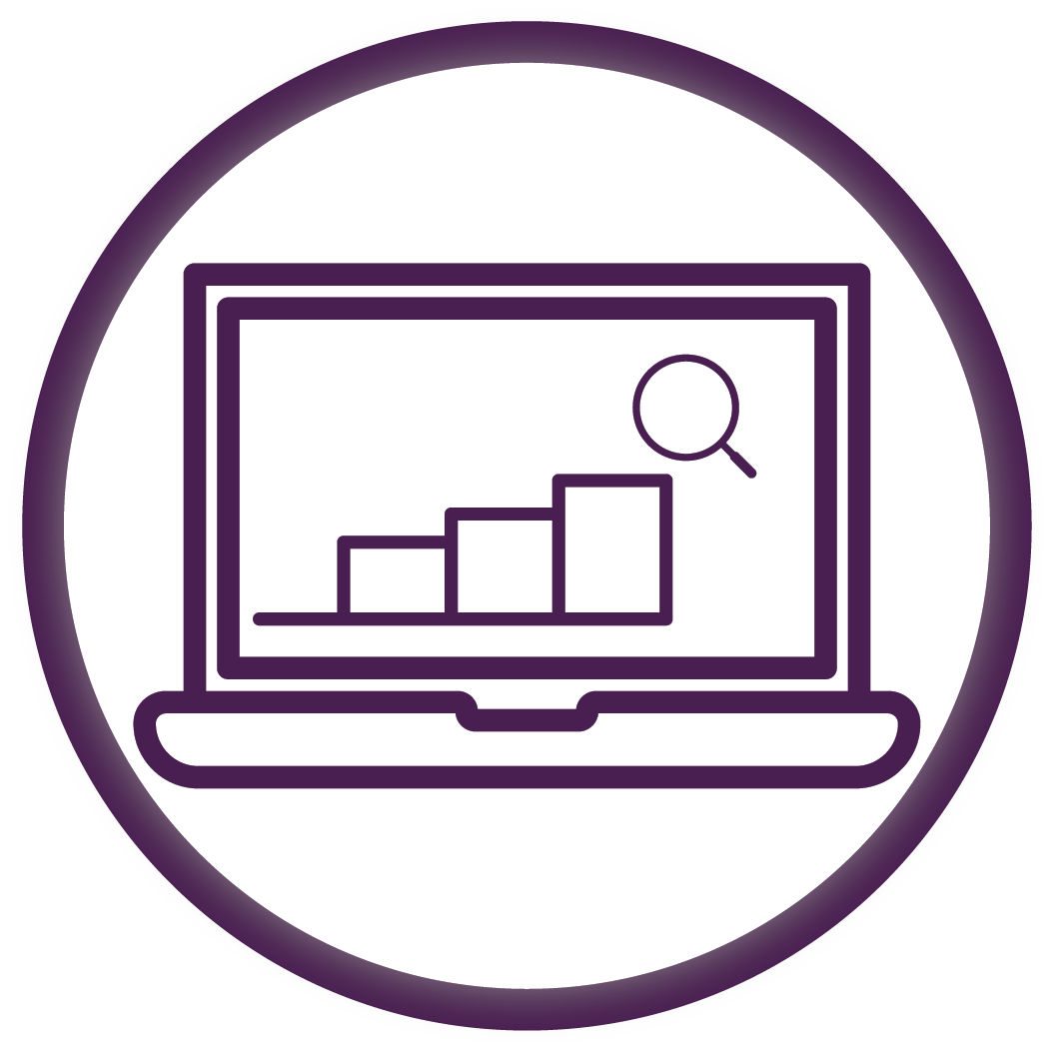
Data
Analytics
Notes:
Let’s begin with Data Analytics!

Slide 8
What is Data Analytics?
Process of analyzing raw data to find trends and answer questions
Notes:
So what is Data Analytics or DA for short?
We said earlier that DA was the process of using data to find insights. Which is true…

Slide 9
What is Data Analytics?
Types of Data Analytics
Descriptive
Predictive
Prescriptive
What Happened?
What Will Happen?
What Should Be Done?
Notes:
…But there is actually 3 different types of Data Analytics – Descriptive, Predictive, and Prescriptive. These 3 types answer the questions What Happened, What Will Happen, and What Should be Done. All of these types of analytics are performed using machine learning, a type of artificial intelligence that uses computer algorithms to evaluate the data over time.

Slide 10
Why is Data Analytics Important?
Policy Noncompliance
Verify policies are being followed
Fraud or Misconduct
Find trends in complex systems that could be indicative of fraud or misconduct
Performance Improvements
Detect operational inefficiencies
Effective Controls
Ensure safeguards and counter-measures are in place and operating effectively
Notes:
Why is Data Analytics Important?
Data Analytics can be used in a variety of industries and for a broad range of business processes.
Our DA tools target 4 key areas – Policy Noncompliance, Fraud or Misconduct, Performance Improvements, and Effective Controls.
Policy Noncompliance within DA helps ensure that your organization’s policies in place are effectively being followed and if not, quickly identifies the anomalies.
Fraud or Misconduct algorithms quickly pinpoints areas that could be of concern.
Performance Improvements identify business areas that could be modified for increased efficiency.
Effective Controls uses algorithms to check that internal controls in place at the organization are operating effectively.

Slide 11
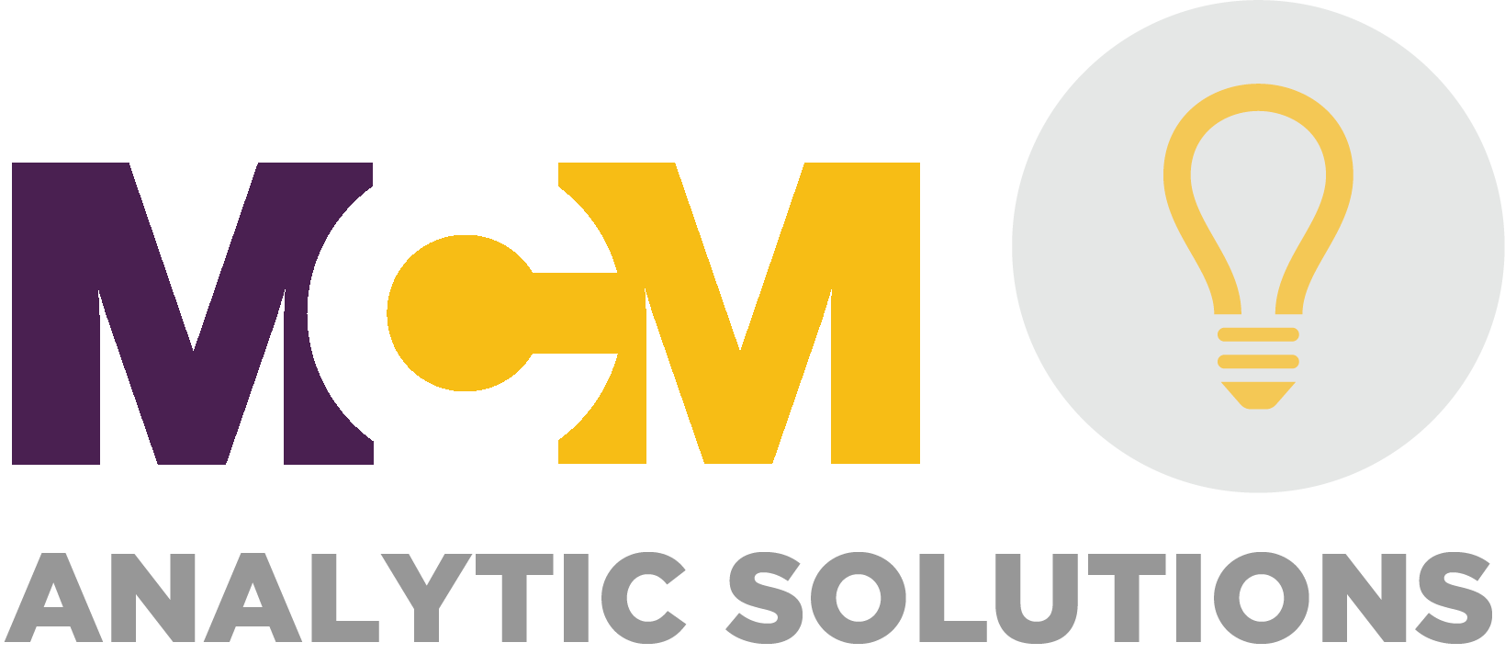
Notes:
All of the data analytics types and areas of importance are built into our Data Analytics Product Line – MCM Analytic Solutions.
MCM Analytic Solutions are on-demand dashboard products that provide clients with graphical insights into their data.

Slide 12
MCM Analytic Solutions
Analytic Solutions for Business Processes
Accounts Payable
Procurement Cards
Accounts Receivable
Time and Expense
Fixed Assets
Analytic Solutions for Industries
Insurance Claims
Financial Institutions Fair Lending
Healthcare
Not-for-Profit
Auto Dealers
Construction
Real Estate
Manufacturing Supply Chain and Inventory
Consumer Analytics
HR Pay Equity
Tier
1
Tier
2
Tier
3
Notes:
We have 2 types of dashboards.
Analytic Solutions for Business Processes offer insights into areas like Accounts Payable, Accounts Receivable, Time and Expense. Things that every organization has.
Analytic Solutions for Industries are products developed specifically to analyze data as it is relevant to organizations within that industry. We have incorporated specific analytics or KPIs into the dashboard.
What you see here, are just some of the ones we have began working with. We are able to work across industries and across business processes.
I know you all are most likely interested in that not-for-profit. That is one specific to the fraternity/sorority sector, but we can certainly talk more about your specific needs and either adapt some of those analytics or create an Analytic Solution specific for you.

Slide 13
Common types of NFP Fraud
Embezzlement and Misappropriation of Funds
False Expense Claims
Vendor Fraud
Fake Donations
Grant Fraud
Notes:
And so what do I mean by analytics specific for your industry or your organization.
Listed here are common types of fraud that occurs in not-for-profits:
Embezzlement and Misappropriation of Funds: This type of fraud involves individuals within the organization diverting funds for personal gain
So we would create an analytical test that focuses on the movement of funds, ensuring money isn’t deposited into employee accounts.
False Expense Claims: You often have employees and volunteers who incur expenses on behalf of the organization. However, some individuals may attempt to submit false expense claims for personal expenses or inflate their reimbursement requests.
So here we would create a test that targets the expense report, the submitter, and the approver and see if there are any unusual activity or trends.
Vendor Fraud: Nonprofit organizations work with various vendors and suppliers to support their operations. However, some vendors may engage in fraudulent activities, such as inflating prices, providing substandard goods or services, or colluding with internal employees.
So here we again take a holistic approach – we can make sure that vendors don’t have employee address, but also compare the goods or services you are receiving based on the invoices between vendors or supplier and we can estimate if there could be any discounts for purchasing more things with one over another.
Fake Donations: Nonprofit organizations heavily rely on donations from individuals, corporations, and foundations. However, fraudulent activities can occur in the form of fake donations or misreporting of donation amounts.
So here we can flag any donations that appear to be fraudulent – could be the address, or the donor themselves, we can also ensure that donations are getting reported correctly on the correct tax forms.
Grant Fraud: Nonprofits often rely on grants from government agencies, foundations, and other funding sources to support their programs and initiatives. Grant fraud can occur when organizations misrepresent their activities, misuse grant funds, or fail to meet reporting requirements.
So here is a great example of noncompliance – most grants are given for specific purposes so we can track to ensure you stay in compliance with those rules.
So these are just some examples, specifically related to the fraud or misconduct category, but you can just imagine the other types of tests and the value you would receive.

Slide 14
What Data Analytics can help in Fraud detection and mitigation?
Anomaly Detection
Trend Analysis
Predictive Modeling
Segmentation Analysis
Real-Time Monitoring
Notes:
Here are some of the aspects of Data Analytics that can be used to detect and mitigate fraud risk.
Data analytics tools can identify unusual patterns or outliers in financial transactions, such as unexpected increases in expenses or irregularities in revenue. These anomalies can be flagged for further investigation, allowing organizations to uncover potentially fraudulent activities. Also, by analyzing patterns and variables associated with past fraud cases, organizations can predict and prevent future fraudulent activities.
Data analytics can segment data based on various criteria, such as vendors, donors, or program areas, to identify areas with a higher risk of fraud. By focusing on specific segments, organizations can proactively monitor and investigate potential fraud within those areas.
Moreover, with the help of data analytics, organizations can implement real-time monitoring of financial transactions, flagging suspicious activities as they occur. This proactive approach allows for immediate intervention and mitigation of fraudulent behavior.

Slide 15
Demo of an Analytic Solution
Notes:
Individual Analytic Solution Application Marketing Sheet Here
Reference P2P Indicator and Fields – remind that these are the required fields to do the analysis for that app, if client cannot provide a field that “test” will not be done
Reference Qlik User Guide
Reference P2P User Guide – remind that the back of the user guide has all tests incorporated into the application
Before moving further, I would now like to show you one of our Business Process Analytic Solutions - Procure to Pay, which is analytics around the accounts payable cycle.
In your BI Packet, you will find a marketing brochure for this application and also another application, Procurement Card. These are examples of what we would give to clients for information about the apps. Also, going around is a listing of all of the tests built into the application with the required fields, that the client would get. If they didn’t have a certain field or didn’t want a specific test then would simply just remove that test from the final dashboard. The other two items going around are the User Guides that clients will receive at onboarding. We will have initial training, but this gives them something to reference later on.
Alright, so let’s begin the demo.

Slide 16
Notes:
Our Analytic Solutions are available through a Cloud-Based Platform called Qlik. This video will have all simulated data, so not all the numbers will make sense, but we have tested this app against actual client data.
To access Qlik, we simply go to our own URL - https://mcmtsg.us.qlikcloud.com/
Each user, whether that be a client user or an internal user of the firm, has their own username and password to login. Each user has to be invited by me, the Qlik Administrator, to join. Once they join, I have to specifically assign them to their own company page and then to their application. This ensures security and separation between our clients.
So, once we get logged in, we come to this main page where Clients are able to pin important graphs from an application that they want to keep an eye on.
To get to their application, Clients click on “Catalog” and then use the drop-down to go to their company page. I have lots of different spaces since I am an administrator. Clients will only have their company page. Once on their company page, clients will see their application(s), whichever Analytic Solution they have chosen.
Today, I am going to show you Procure to Pay. Users simply click on the app to open it. The main page of the application will open up with a brief overview of the application and buttons to navigate within the app.
Since this app is around the Accounts Payable cycle, we have 5 categories that a client can navigate to. Let’s say a client first wants an overall overview, so they go to Executive Summary.
On each page or sheet within the application, there are filters at the top to help narrow in on results. Below the filters, you see some KPIs, as well as various graphs of the data, and then at the bottom there is always a table of all of the data. All graphs and charts are interactive where users can click on a time-period or name and all of the data on the page will change.
For example, we see Puma North America has a high Vendor Risk Score. If we click on them, we see all of the graphs at the top adjust. We also have built in this table at the bottom of each sheet showing detail of the data.
It is important to note that any selections we make need to be cleared manually or they will carry over to any of the other sheets we go to.
Now let’s say our client wanted to get more insights on their vendors. They can navigate to the vendors sheet where they first come to an executive summary type page specific for vendors. You will see at the top they have filters to choose from again, as well as KPIs and other interactive graphs and tables. The new thing here is this area at the top where they can choose a test to see the results.
These are the tests we have developed specific for the vendor analysis. This application has near 70 tests in total across all 5 categories.
Let’s see how many vendors have a PO Box address. The computer algorithm found 108 vendors with PO boxes and 66 of those are active. It is up to the client to make decisions about them. So the table at the bottom can be exported if the client wanted to dig deeper, but they can also see the information on the graphs on this sheet. All the graphs/charts/tables within this application can be exported in image, pdf, or excel formats. Now, we know that PO Box addresses are often susceptible to fraud so we would want them to keep an eye on this page.
All of the functionality shown here and some other features not shows are further explained in our User Guides that each client user will receive as reference.
In creating the applications, we worked hard to keep colors consist for each category area, we incorporated banners and icons for all of the tests which also match the user guide. We will also provide an initial training/onboarding session to our client users.
That is just a quick overview of the application, Procure to Pay is one of our larger applications just because the data is pulled from various areas, but the functionality and structure you see here is what we have for all our of Analytic Solutions.

Slide 17
MCM Analytic Solutions
Onboarding upon receiving data < 2 weeks
Can choose between a one-time or ongoing analysis
Pricing varies by the frequency of the analysis
Notes:
So those were just some potential examples that we can build into a NFP Analytic Solution.
For MCM Analytic Solutions that are already developed, we offer quick onboarding. We simply duplicate the original template and add in your data. Therefore, once we receive the correct data it should take less than 2 weeks to get the dashboard created and your team trained in using the system. For those Solutions that need to be created, it takes us about 8 weeks to get you onboarded.
The amount of data that each dashboard holds can range from a couple months to 10+ years, it depends on what you want to see. We will load in historical data during the onboarding processes then you can choose how often the dashboard gets updated with new data – whether it be one-time, every day, every week, every month, or every quarter. We simply set up an automated scheduler based on your selection.
Of course, the pricing of the solutions will vary depending on the frequency of the update chosen. The pricing is not affected by how much historical data goes into the initial onboarding.

Slide 18
MCM Analytic Solutions Pricing
1-Year Contract Price
One-Time
Quarterly
Monthly
Weekly
Daily
Notes:
So again, our pricing is based on how often you want the dashboard to be updated, but you will have access to the dashboard for the entirety of the annual contract period.

Slide 19
Business Intelligence Services
Data Analytics
Data Strategy
Notes:
That wraps-up the introduction to Data Analytics Services and specifically how they relate to NFP. Let’s move on to the second service MCM currently offers under the BI Service line….

Slide 20
Data
Strategy
Notes:
Data Strategy!

Slide 21
Statistics of Nonprofits Using Data
In a survey of 460 nonprofit professionals,
90% said their organizations are collecting data
46% said their data is spread across multiple systems and software platforms
50% said they use software to collect and analyze data as part of their email programs and donor management processes
Sources: https://online.maryville.edu/blog/data-science-for-social-good/
Notes:
Source: https://online.maryville.edu/blog/data-science-for-social-good/
So here are just some stats on NFP data. 90% say they are collecting data, 46% say their data is spread across systems, and 50% say they use some type of analytics related to email and donor management.

Slide 22
What is Data Strategy?
Focuses on how companies acquire, store, manage, share, and use data
Notes:
So what is Data Strategy?
Data strategy is how companies gather, store, manage, share, and use their data.

Slide 23
Why is Data Strategy Important?
Many organizations do not understand what data they have or what they can do with it.
Notes:
Data Strategy is way to help you understand what data you have and what you can do with it.

Slide 24
Data Strategy Consultation
Data Roadmap Development
Assess the quality of client’s data to get the most out of what they already have
Business Process Evaluation
Assess the flow of client’s data to identify areas of inefficiency
Develop a tailored vision based on client’s organizational goals
Develop policies and procedures that ensure the security and governance of client’s data
Data Systems Evaluation
Assess security, performance, and precision of client’s data systems
Develop recommendations for each data system
Notes:
Data Strategy is designed as a consultation service. I understand that the items I discuss today are brand new to some of you or a recap to others. We have some that have heard the buzzwords, but do not know what they mean or what to even do. We have others that know what they need to do, but just don’t know how. And we have others that know what they want, have tried building on their own, and they just need help with where to go now.
So, Data Strategy helps us address all those issues with 3 product offerings. We have Data Roadmap Development – where we can assist in helping you understand the quality of your data and what you can do with it right now. We work with you to create a custom roadmap to achieve your organization’s goals. We have Business Process Evaluation – where we help you ensure you have secure and efficient processes in place when it comes to the flow of data within your organization. We help you develop written policies and procedures to ensure data governance. We also have Data Systems Evaluation – where we evaluate the security, performance, and precision of your data systems and provide recommendations for those systems.

Slide 25
Data Strategy
Tailored client consultation services developed upon a standardized framework
Pricing based on framework requirements and initial discussions on client needs
Notes:
The 3 types of data strategy consulting services are developed from a standardized framework that allows for customization to your organization.
The pricing for the consultation services will be based on the budgeted time it will take to get through the framework’s workpapers and adjusted for your needs.
Simply put, it’s priced as a normal consulting service engagement would be.

Slide 26
Business Intelligence Services
Data Analytics
Data Strategy
Notes:
That wraps-up the introduction to Data Strategy Services.

Slide 27
Value & Benefits of Business Intelligence Services
Notes:
At the start of this presentation, I asked you all 3 questions – how hard is it for you to accurately measure KPIs, find employee abuse, and close your books timely?
Those are just some of the areas our services can address. But I would like to show you some real examples of the impact of analytics.

Slide 28
"Organizations are investing trillions to become more data-driven, but only 8% successfully scale analytics to get value from their data."​
"Data-driven organizations are now 23x more likely to acquire customers, 6x as likely to retain customers, and 19x more likely to be profitable."
"Using big data to the fullest can increase a business' operating margin by more than 60%."
Sources: Gartner, McKinsey, Forbes, BARC Reports, NewVantage Partners, IBM, Nucleus Research
Notes:
Organizations are facing more challenges now than ever. You are trying to protect your company against fraud, ensure compliance, while also achieving your growth goals.
Data analytics is an important tool to help organizations make better predictions and decisions in a timely manner. However, most companies don't know how to use the data they already have. We are able to put your data into a consumable format that can have a huge impact on your organization.

Slide 29
On average, it takes 16 months to find PCard fraud
The typical organization will have a median loss of $130,000 per case
Organizations that proactively monitor data using an automated risk management solution detected frauds in less than half the time, with 52% lower fraud losses
Immediate access to reports can identify fraud in a timely manner
Notes:
For example, Procurement card fraud is one of the most common occurring types of employee fraud and it can be costly.
Companies must continue to monitor spending, but since only 8 percent of organizations fully utilize their data, it is more likely that this type of fraud can slip through the cracks.
Most companies do not have time or resources to continuously monitor for suspicious activity. More than $7 billion have been lost annually due to fraud.
However, with our MCM Analytic Solutions dashboard products, our clients will have immediate information to help them monitor fraud.
Our business intelligence services, help our clients become more efficient, proactive and use their data to achieve their goals. It allows companies to use the time they would normally spend on finding fraud and put it towards policies and best practices to combat it.
These are just examples for one Analytic Solution, you can imagine the value of all the others.

Slide 30
Use Case:
Enhancing Donor Engagement and Fundraising Efficiency through Data Strategy and Data Analytics in a Non-profit Organization
Notes:
I would like to move now into a Use Case to tell you more about using BI within NFP
So this case relates specifically to enhancing donor engagement and fundraising efficiency through Data Strategy and Analytics.

Slide 31
Introduction:
A non-profit organization: Hope for Tomorrow
Organization’s mission: Provide education and healthcare support to underprivileged children
Notes:
The organization we will focus on is a not-for-profit called Hope for Tomorrow, which aims to provide education and healthcare support to underprivileged children in developing countries.

Slide 32
The Highlights of challenges faced by Hope for Tomorrow:
Engaging donors effectively
Allocating resources efficiently
Optimizing fundraising efforts
Notes:
Hope for Tomorrow faced challenges in effectively engaging donors, ensuring the efficient allocation of resources, and optimizing fundraising efforts.
They needed a data-driven approach to gain insights into donor behavior, identify potential donors, personalize communications, and measure the impact of their programs.

Slide 33
How can Data Strategy help?
Notes:
So I know I introduced Data Analytics to you first, but normally we all need to start with Data Strategy.

Slide 34
Action 1: Understand Data Framework
Evaluate existing data landscape
Identify gaps, challenges, and opportunities
Notes:
First of all, you must understand the data framework within the organization. So this is something MCM can help you with, but most of the time you have someone in the organization that knows about the infrastructure and systems.
Specific for Hope for Tomorrow, they conducted an evaluation of the organization’s current data landscape, including data sources, infrastructure, system, processes, and governance practices. Then they identified gaps, challenges, and opportunities for improvement that would lead to enhanced data quality, data privacy and security, and data management.

Slide 35
Action 2: Develop a Data Roadmap
Define Goals and Objectives
Identify Key Data Needs
Develop Data Governance and Security Framework
Data Collection and Integration Strategy
Notes:
So by doing that assessment, they were able to clearly define their goals and objectives. So when it was time to develop a data roadmap they knew the end goal, just needed help getting there.
And those goals could include improving donor engagement, optimizing fundraising efforts, measuring program impact, or enhancing operational efficiency.
Having specific goals will guide the development of the data roadmap and ensure alignment with the organization's overall strategy.

Slide 36
Action 2: Develop a Data Roadmap
Define Goals and Objectives
Identify Key Data Needs
Develop Data Governance and Security Framework
Data Collection and Integration Strategy
Notes:
Once they had those goals, it was time to identify the data needed that align with the organization's goals and objectives. This involves determining the types of data required, such as donor information, program metrics, financial data, and communication data. Consider both internal data sources (existing databases, systems, and records) and external data sources (publicly available data, third-party data) that may provide valuable insights.
For Hope for Tomorrow, they found they were not tracking all of the data they needed for the analysis they wanted.

Slide 37
Action 2: Develop a Data Roadmap
Define Goals and Objectives
Identify Key Data Needs
Develop Data Governance and Security Framework
Data Collection and Integration Strategy
Notes:
So they then establish data governance policies and procedures to ensure data quality, privacy, and security. They defined data access controls, data ownership, data validation processes, and data retention policies. They implemented security measures to protect sensitive data and ensure compliance with relevant regulations, such as data protection laws.

Slide 38
Importance of Data Quality, Privacy, and Security
Ensuring the accuracy, completeness, consistency, and reliability of data
Implementing measures to protect sensitive data from unauthorized access, breaches, and misuse.
Notes:
So quick detour here – I keep saying Data Quality, Privacy and Security.
Data quality refers to the accuracy, completeness, consistency, and reliability of data.
It is essential because high-quality data ensures that analytical decisions are based on accurate and reliable information, leading to better business outcomes and reduced risks.
Data privacy and security involve protecting sensitive data from unauthorized access, breaches, and misuse. This includes adhering to data privacy regulations, establishing data security protocols, and ensuring compliance with industry standards.

Slide 39
Action 2: Develop a Data Roadmap
Define Goals and Objectives
Identify Key Data Needs
Develop Data Governance and Security Framework
Data Collection and Integration Strategy
Notes:
So back to the last part of the data roadmap development.
Here we identify the sources of data that are relevant to your goals and establish mechanisms for collecting and integrating that data.
In the use case, Hope for Tomorrow implemented a robust data collection strategy to capture various types of data related to donors, including demographics, past donations, communication preferences, and interactions with the organization. The organization also collected donor information through online forms, email marketing tools, surveys, event registrations, and offline interactions. Collecting diverse and relevant data about donors enables a deeper understanding of their preferences and behaviors. And then integrate data from multiple sources into a centralized database for comprehensive analysis.

Slide 40
How can Data Analytics help?
Notes:
So now that the data is ready. We move to analytics.

Slide 41
Donor Segmentation
Segment the donors base into distinct groups, based on:
Donation frequency
Donation amount
Communication preferences
Notes:
(Descriptive Analytics)
To enhance donor engagement and response rates, Hope for Tomorrow employed advanced analytics techniques to segment their donor base into distinct groups. This segmentation was based on various factors, including donation frequency, donation amount, and communication preferences. By categorizing donors into specific segments, the organization could tailor their messaging and outreach strategies to meet the unique needs and preferences of each group.
Analyzing the donor historical data to identify patterns and trends that could inform the segmentation strategy. They examined donation frequency to identify donors who consistently contributed over time versus those who donated sporadically. Donation amount was considered to distinguish between major donors and regular contributors. Communication preferences were also taken into account to understand how donors preferred to be contacted and engaged with the organization.

Slide 42
Fundraising Performance Analysis
Donation Amounts
Response Rates
Conversion Rates
Campaign ROI
Donor Feedback
Notes:
(Descriptive Analytics)
The organization implemented performance metrics to measure the effectiveness of their fundraising efforts. They examined metrics such as donation amounts, response rates, campaign ROI, donor feedback and conversion rates to evaluate the effectiveness of each campaign.
For example, they determined if specific campaigns or messaging resulted in higher or lower donation amounts. This information allowed them to refine their fundraising strategies and focus on approaches that yielded higher donation levels. Also, they tracked the costs associated with each campaign, including marketing expenses, staff time, and other resources. By comparing these costs to the funds raised, they could determine the financial impact of each campaign. This enabled them to prioritize campaigns that delivered a higher ROI and allocate resources more effectively.
By comparing the results of different campaigns, they were able to identify which strategies and approaches resonated best with their donors, enabling them to refine their future campaign strategies accordingly.

Slide 43
Identify key factors for Donor Engagement
Personalized thank-you messages
Regular updates on program impact
Invitations to exclusive donor events
Notes:
(Predictive Analytics)
After analyzing their historical donor data, Hope for Tomorrow identified key factors that influence donor loyalty and engagement. They discovered that donors who received personalized thank-you messages, regular updates on program impact, and invitations to exclusive donor events were more likely to remain engaged and increase their support.

Slide 44
Prospect Identification for Future Donors
Built predictive models to identify likely donors.
Prioritized and targeted prospects based on model probabilities.
Efficiently allocated resources for fundraising impact.
Notes:
(Predictive Analytics)
Also through predictive analytics, they were able to identify common characteristics, behaviors, and attributes shared by individuals who had previously contributed. They established a foundation for predictive modeling to identify potential donors with a higher likelihood of contributing. Armed with their predictive models, Hope for Tomorrow could prioritize and target prospects with a higher likelihood of becoming donors. This enabled the organization to allocate their resources more efficiently by focusing on prospects with the highest probabilities, thereby maximizing their fundraising efforts.

Slide 45
Actionable Recommendations for Hope for Tomorrow
Develop personalized communication strategies
Send personalized thank-you emails immediately after a donation
Provide quarterly impact reports with success stories
Organize an annual donor appreciation gala
Notes:
(Prescriptive Analytics)
Prescriptive analytics takes data analytics a step further by providing organizations with actionable recommendations and strategies to achieve desired outcomes.
In the case of Hope for Tomorrow, they developed personalized communication strategies for each donor segment. They created targeted email campaigns, tailored fundraising appeals, and customized event invitations based on individual preferences and interests.
They sent personalized thank-you emails immediately after a donation. This helps donors feel appreciated and recognized for their contributions, fostering a sense of connection and gratitude.
They provided quarterly impact reports with success stories. Sharing tangible examples of the organization's impact keeps donors informed and engaged, showcasing the difference their support makes.
They organized an annual donor appreciation gala: Hosting an exclusive event for donors provides a unique opportunity to strengthen relationships, network with like-minded individuals, and create a sense of community.

Slide 46
Driving Success in Data Analytics
Implementation and Monitoring
Refinement and Continuous Improvement
Notes:
Hope for Tomorrow recognized the importance of not only implementing data analytics strategies but also closely monitoring the results and continuously improving their approach. They implemented the recommended strategies based on data analytics insights and closely monitored the outcomes. This involved tracking response rates, donation patterns, and donor feedback to evaluate the effectiveness of their actions. By monitoring these metrics, they gained valuable insights into the level of engagement and the impact of their personalized communication strategies and tailored outreach efforts.
However, they didn't stop at implementation and monitoring. They understood that continuous improvement was crucial for sustained success in data analytics. They embraced a culture of ongoing refinement and learning. Through meticulous analysis of the collected data, they identified areas for improvement and made data-driven decisions to optimize their strategies. By carefully assessing the impact of each action and scrutinizing the data, they could identify any gaps or inefficiencies in their approach. They used the insights gained from ongoing monitoring and analysis to guide their decision-making process and refine their strategies.

Slide 47
Driving Success in Data Analytics
Notes:
Data analytics journey is a dynamic process that involves continuous exploration, learning, and adaptation. It is not a one-time implementation but rather an ongoing effort to extract insights and drive actionable decisions from data.

Slide 48
Enhancing organizations to grow and stay ahead of the curve with curated solutions.
Notes:
At MCM, we are dedicated to helping our clients in a holistic approach, giving them the tools and experience to take their business to the next level.
We work with you to increase the effectiveness of your people, processes and technologies through our tailored services.

Slide 49
Benefits
Instills confidence and improves timeliness of decision making
Detects business concerns promptly
Enhances overall business performance
Creates opportunities to forecast trends and proactively address problems
Notes:
You saw the benefits and the impact one organization got from using Data Strategy and Analytics.
But as far as benefits to you.
The products I introduced to you today, help you become confident in the data you are receiving and, because these dashboards have the ability to be updated daily, you can make decisions in a timely manner.
The tests built into the Analytic Solutions, AND the consulting services we have developed, both help you detect areas of concern and understand where business performance can be enhanced.
Lastly, the Analytic Solutions create opportunities to forecast trends, therefore allowing you to be proactive rather than reactive.

Slide 50
Questions?
Business Intelligence Services
Data Analytics
Data Strategy
Notes:
So that concludes the presentation about MCM’s Business Intelligence Services. I will take any questions.

Slide 51
Coming Winter 2023…
Business Intelligence Services
Data Analytics
Data Strategy
Robotic Process Automation
Notes:
But coming this Winter, we will be adding another service to Business Intelligence – Robotic Process Automation. Here, we can truly help you automate some of those tedious daily tasks to allow your people to focus on more important things and we can even connect automation with analytics! If you are interested in learning more, please reach out!

Slide 52
Tayaba Nadeem Business Intelligence Services Team Leader 317.224.1289 Tayaba.Nadeem@mcmtsg.com
Notes:
Here is my contact information, if you think of additional questions or are ready to discuss more on our Business Intelligence Services.
Thank you for your time!

